Slide 1
Statistical problems - statistical summaries
Numerical summaries of data

Slide 2
how to use Oak lessons

Slide 3
I can choose appropriate statistical measures to explore a statistical problem.

Slide 4
A statistical summary sums up the features of a data set. It may contain the average (mean, median and/or mode) which measure the central tendency. It may also contain the range which measures the spread.
The spread/dispersion of data values describes how far apart the pieces of data are.
A measure of central tendency is a summary measure that attempts to describe a whole set of data with a single value that represents the middle or centre of its distribution.

Slide 5

Statistical problems - statistical summaries
Problems with statistical measures based on the data
Choosing statistical measures based on the context

Slide 6

Problems with statistical measures based on the data
During a data handling investigation you need to decide how to analyse the data, once it has been collected and organised.
Planning the statistical enquiry and asking a question
Outcomes and actions
Collection of data
data cycle
Organisation and presentation of data
Interpretation of the data
Analysis of the data

Slide 7
Problems with statistical measures based on the data
For large datasets, it can be difficult to get a sense of what the data tells us.
For example, the data below are from The Met Office and show total rainfall (mm) per month for two regions of the UK in 2021-22.
Cardiff
Stornoway
162.8 100.6 92.6 19.6 202 39
101.8 62.8 29 227 26.4 125.6
65.4 116.8 62.4 44.4 53.4 82.2
13 27.8 78.6 128.6 179.4 165.2
123.6 172 54 98.2 123.2 41.8
58.4 73.6 67 123.4 213.4 167
110.4 114.4 145.8 47.4 69.2 25.4
32.2 47 125.8 214.6 175.6 114.4
It is not obvious which region gets more rainfall.
If we had used data from 1942-2022, there would be 960 numbers in each set.

Slide 8
Problems with statistical measures based on the data
Statistical summaries can be used to represent an entire dataset with a small amount of information.
Statistical summaries can make it easier to make comparisons or draw conclusions from data.
Cardiff
Stornoway
mean rainfall (mm) per month = 91.3
mean rainfall (mm) per month = 105.7
It is easier to see that Stornoway got more rainfall on average than Cardiff.

Slide 9
Problems with statistical measures based on the data
Statistical summaries may include averages and measures of spread for a dataset.
An average is a single number expressing the central or typical value in a set of data. These include:
The mean is calculated by adding up the data points and then dividing by the number of points.
The median is the most central (middle) piece of data.
The mode is the data value with the highest frequency
The spread of a dataset can be measured using the range, by subtracting the lowest value from the highest value.

Slide 10
Problems with statistical measures based on the data
The statistical summaries below are based on weather data from The Met Office for two regions in the UK. The data is about maximum daily temperatures from 1957-2022.
Heathrow
Armagh
median = 14.9
median = 13
range = 27.5
range = 21.5
Which town tends to be warmer?
In which town are the temperatures more consistent?
Heathrow
Armagh

Slide 11
Problems with statistical measures based on the data
Not all types of averages are appropriate for every dataset.
For example, the data below is from a survey of ten people about how they travel to work.
car
bus
walk
walk
car
walk
car
bus
walk
bicycle
The mean and median can only be used to represent numerical data, so are not appropriate averages to summarise this dataset.
The mode would be an appropriate average for this data.

Slide 12

Problems with statistical measures based on the data
The mean is always the best average to use.
The usefulness of an average can depend on the data that has been collected.
The mean performs a calculation using ever data point in the set.

Slide 13


Problems with statistical measures based on the data
Lucas collects data about the favourite genres of books from a sample of pupils in his school.
Which would be the most appropriate measure of average for Lucas’s data?
a
mean
comedy horror fantasy sci-fi romance
b
median
c
mode

Slide 14
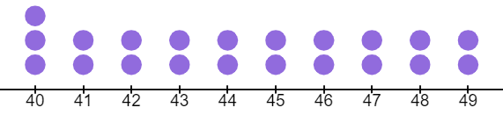
Problems with statistical measures based on the data
The usefulness of an average may depend on the shape of the data.
The data below represents scores on a test for a class.
median = 44
mode = 40
mean = 44.3
The mode does not give an accurate representation of the class.

Slide 15
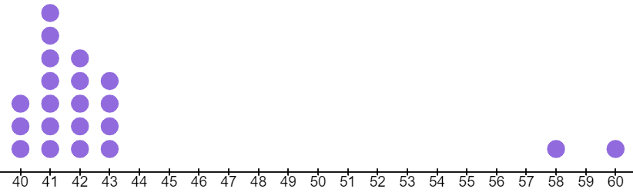
Problems with statistical measures based on the data
The usefulness of an average may depend on the shape of the data.
The data below represents scores on a test for another class.
mean = 43.1
mode = 41
median = 42
The mean does not give an accurate representation of the class.

Slide 16
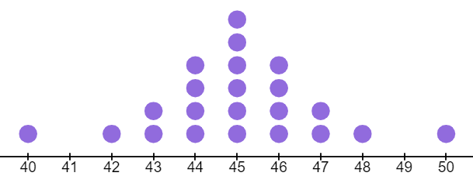
Problems with statistical measures based on the data
The usefulness of an average may depend on the shape of the data.
The data below represents scores on a test for another class.
mean = 45
mode = 45
median = 45
All the averages give a similar representation of the data.

Slide 17
Problems with statistical measures based on the data
Which measure of average would be different to the others in this set of numbers?
1, 1, 1, 5, 6, 7, 10, 11, 12
mean
median
mode

Slide 18
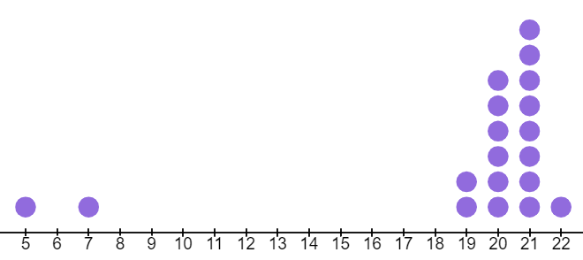
Problems with statistical measures based on the data
Which measure of average is least representative for the majority of data in this dataset?
mean = 18.9
median = 20
mode = 21
mean
median
mode

Slide 19
Problems with statistical measures based on the data
1) The four sets of data all have a mean of seven. In which sets of data do you think that this average provides a good summary of the information? Give reasons for your answers.
a) 1, 1, 1, 1, 1, 1, 43
b) 7, 7, 7, 7, 7, 7, 7
c) 1.5, 2.8, 6.1, 6.9, 7.9, 9.4, 14.4
d) 4, 5, 6, 7, 8, 9, 10
2) Find the mean, median and mode for the set of data.
1, 2, 3, 3, 4, 4, 5, 6, 9, 9, 9
Which average least represents the central tendency for this data? Explain why.

Slide 20

Problems with statistical measures based on the data
1) The four sets of data all have a mean of seven. In which sets of data do you think that this average provides a good summary of the information? Give reasons for your answers.
43 is much bigger than all of the other numbers, which are all equal to 1.
a) 1, 1, 1, 1, 1, 1, 43
All of the numbers are 7.
b) 7, 7, 7, 7, 7, 7, 7
c) 1.5, 2.8, 6.1, 6.9, 7.9, 9.4, 14.4
7 is around the centre of the data and many of the numbers are close to 7.
d) 4, 5, 6, 7, 8, 9, 10
7 is in the centre of the data. Each number that is below 7 has a matching pair which is just as much above 7.

Slide 21
Problems with statistical measures based on the data
2) Find the mean, median and mode for the set of data.
1, 2, 3, 3, 4, 4, 5, 6, 9, 9, 9
mean = 5 median = 4 mode = 9
Which average least represents the central tendency for this data? Explain why.
the mode
The mode happens to be equal to the highest value in this data.

Slide 22
Statistical problems - statistical summaries
Problems with statistical measures based on the data
Choosing statistical measures based on the context

Slide 23
Choosing statistical measures based on the context
The choice of average in a statistical summary can depend on the context in which it is being used.
The type of data used can cause some measures of average to make less sense than others in context (e.g. if the data is non-numerical).
The shape of data can cause some measures of average to be less representative than others for that data.
Sometimes, the measure of average that someone chooses to use may depend on what message they are trying to communicate.

Slide 24
Choosing statistical measures based on the context
A shoe shop sells pairs of shoes in lots of different sizes.
The manager is planning how many pairs of each size to stock. They intend to use averages to inform their decision.
The data below shows sizes of the last 19 pairs of shoes that they sold.
2, 3, 4, 4, 5, 5, 5, 6, 6, 7, 8, 8, 9, 9, 9, 10, 10, 12, 13
Find the mean, median and mode of this data.
mean = 7.1 median = 7 mode = 5 and 9
Which measure of average do you think the manager should use?

Slide 25
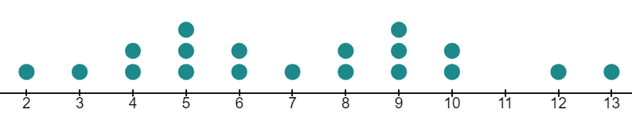
Choosing statistical measures based on the context
Here is the same data represented on a dotplot.
modes
median
mean = 7.1
The shape of the data shows that the median, in this case, was one of the least popular shoe sizes. It would not be helpful to stock lots of size 7 shoes.

Slide 26
Choosing statistical measures based on the context
Here is the same data represented on a dotplot.
modes
median
mean = 7.1
The mean suggests stocking more shoes that are sizes 7 and 8, but these were the least popular shoe sizes.

Slide 27
Choosing statistical measures based on the context
Here is the same data represented on a dotplot.
modes
median
mean = 7.1
The mode tell the shop manager the most typical shoe sizes sold. This would be the most appropriate measure of average for this context.
The dot plot highlights why using the median or mean could have resulted in making inappropriate decisions, in the context of this problem.

Slide 28
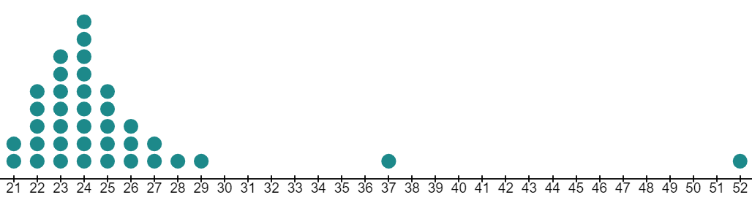
Choosing statistical measures based on the context
A company has 37 employees. The dotplot shows the salary of each employee, rounded to the nearest thousand pounds.
mode = 24
mean = 25.1
median = 24
(£ thousands)
Which measure of average could be used to give the impression that people are paid well?
mean

Slide 29
Choosing statistical measures based on the context
A company has 37 employees. The dotplot shows the salary of each employee, rounded to the nearest thousand pounds.
mode = 24
mean = 25.1
median = 24
(£ thousands)
Which measure of average could be used to give the impression that people are paid less well?
median or mode

Slide 30

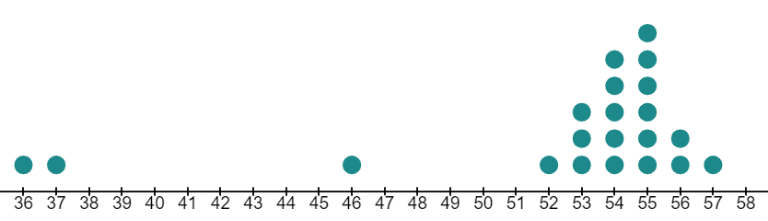
Choosing statistical measures based on the context
The data shows Sofia’s last 21 scores on a video game. Which average would be most useful to suggest that Sofia has scored well?
mean
mean = 52.3
median = 53
mode = 54
median
mode

Slide 31
Choosing statistical measures based on the context
The data shows Sofia’s last 21 scores on a video game. Which average would be most useful to suggest that Sofia has not scored well?
mean
mean = 52.3
median = 53
mode = 54
median
mode

Slide 32
Choosing statistical measures based on the context
1) The table contains data from The Met Office about the weather in Cambridge in 2004. It shows the number of days in each month where there was frost.
month | Jan | Feb | Mar | Apr | May | Jun | Jul | Aug | Sep | Oct | Nov | Dec
no. days | 7 | 11 | 3 | 0 | 0 | 0 | 0 | 0 | 0 | 0 | 3 | 9
a) Find the mean number of days of frost in a month, giving your answer to 2 decimal places.
b) Find the median number of days of frost in a month.
c) Find the mode.
d) Which measure of average would be the least useful for describing the amount of frost that could be expected during a typical month in Cambridge? Explain why.

Slide 33
Choosing statistical measures based on the context
2) A homeowner is selling their house. The data below shows the prices for the last five houses that were sold on the same street.
£150 000 £350 000 £360 000 £350 000 £210 000
a) Find the mean and median house price.
b) Which average suggests that houses here are worth more money?
c) Which average suggests that houses here are worth less money?
d) Which average might the seller prefer to use?
e) Which average might the buyer prefer to use?

Slide 34
Choosing statistical measures based on the context
1) The table contains data from The Met Office about the weather in Cambridge in 2004. It shows the number of days in each month where there was frost.
month | Jan | Feb | Mar | Apr | May | Jun | Jul | Aug | Sep | Oct | Nov | Dec
no. days | 7 | 11 | 3 | 0 | 0 | 0 | 0 | 0 | 0 | 0 | 3 | 9
2.75
a) Find the mean, giving your answer to 2 decimal places.
0
b) Find the median.
0
c) Find the mode.

Slide 35
Choosing statistical measures based on the context
month | Jan | Feb | Mar | Apr | May | Jun | Jul | Aug | Sep | Oct | Nov | Dec
no. days | 7 | 11 | 3 | 0 | 0 | 0 | 0 | 0 | 0 | 0 | 3 | 9
d) Which measure of average would be the least useful for describing the amount of frost that could be expected during a typical month in Cambridge? Explain why.
the mean
It would suggest that each month typically has 2-3 days of frost, but most months do not have any frost.

Slide 36
Choosing statistical measures based on the context
2) A homeowner is selling their house. The data below shows the prices for the last five houses that were sold on the same street.
£150 000 £350 000 £360 000 £350 000 £210 000
mean = £284 000 median = £350 000
a) Find the mean and median house price.
the median
b) Which average suggests that houses here are worth more money?
the mean
c) Which average suggests that houses here are worth less money?
the median
d) Which average might the seller prefer to use?
the mean
e) Which average might the buyer prefer to use?

Slide 37
Statistical problems - statistical summaries
The type of data that we are handling may mean that certain statistical measures are not appropriate.
The nature of the data may mean that certain statistical measures are not appropriate.
Certain statistical measures may not make sense in the context of the data.

Slide 38

© Oak National Academy 2023.
Produced in partnership with Mathematics in Education and Industry.
Licensed on the Open Government Licence v3.0, except where otherwise stated. See Oak terms and conditions.

